Slide 1

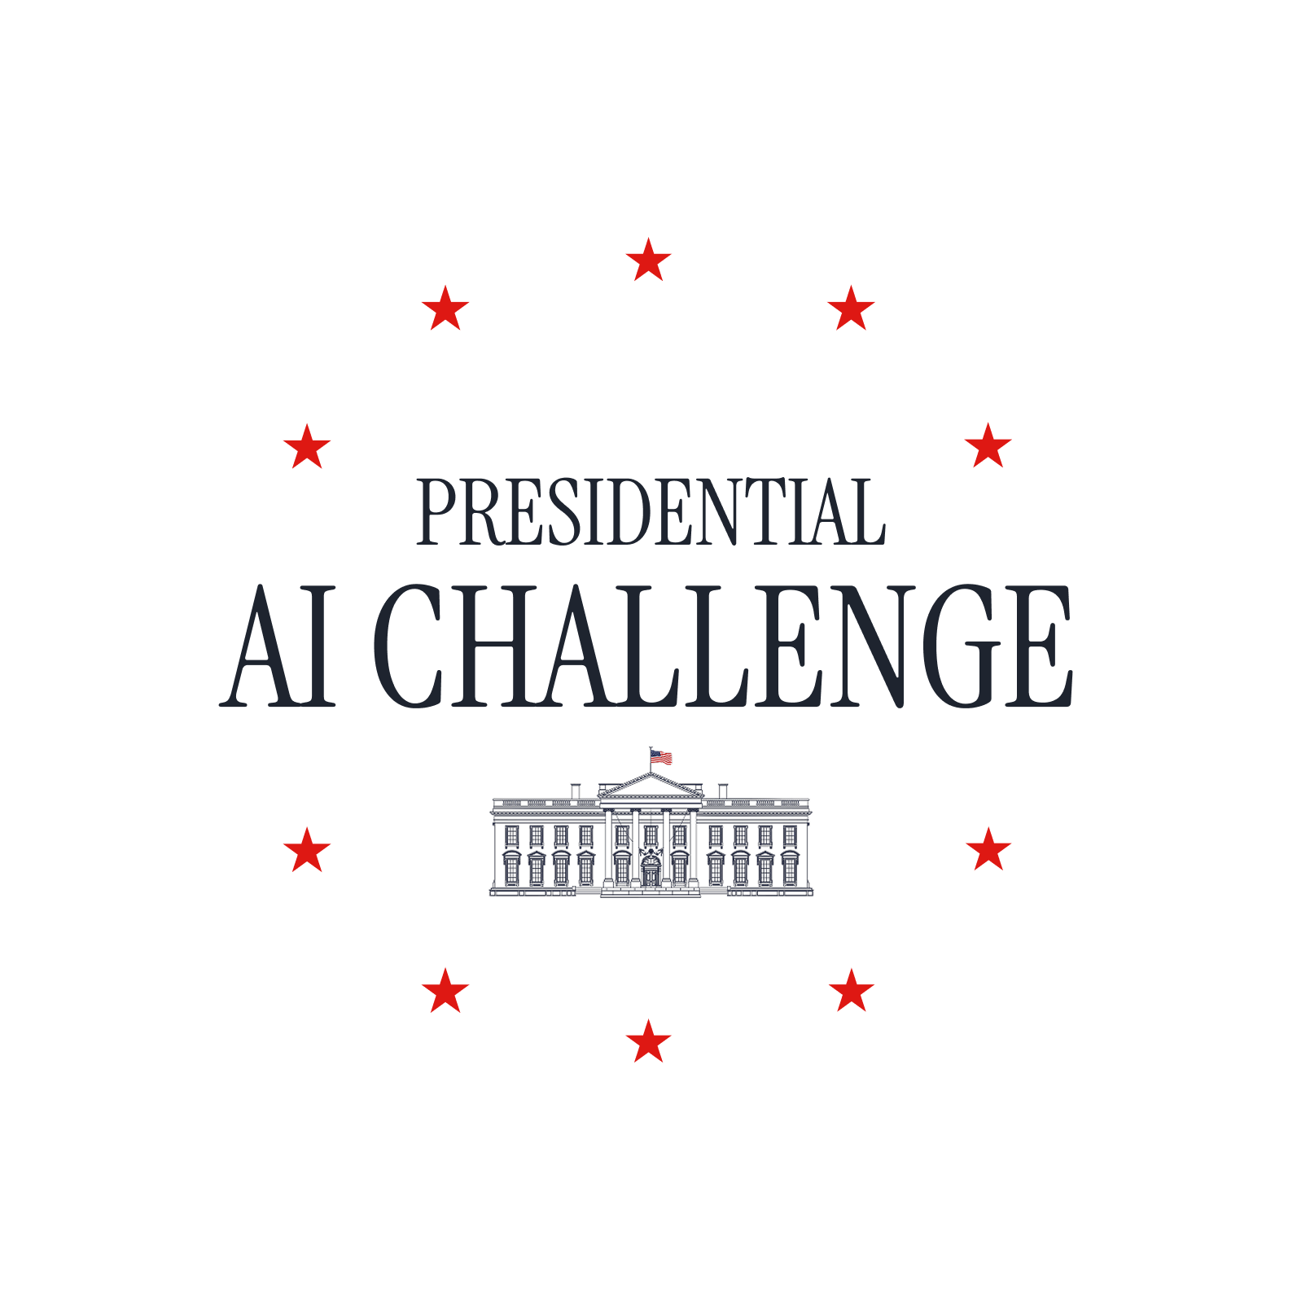
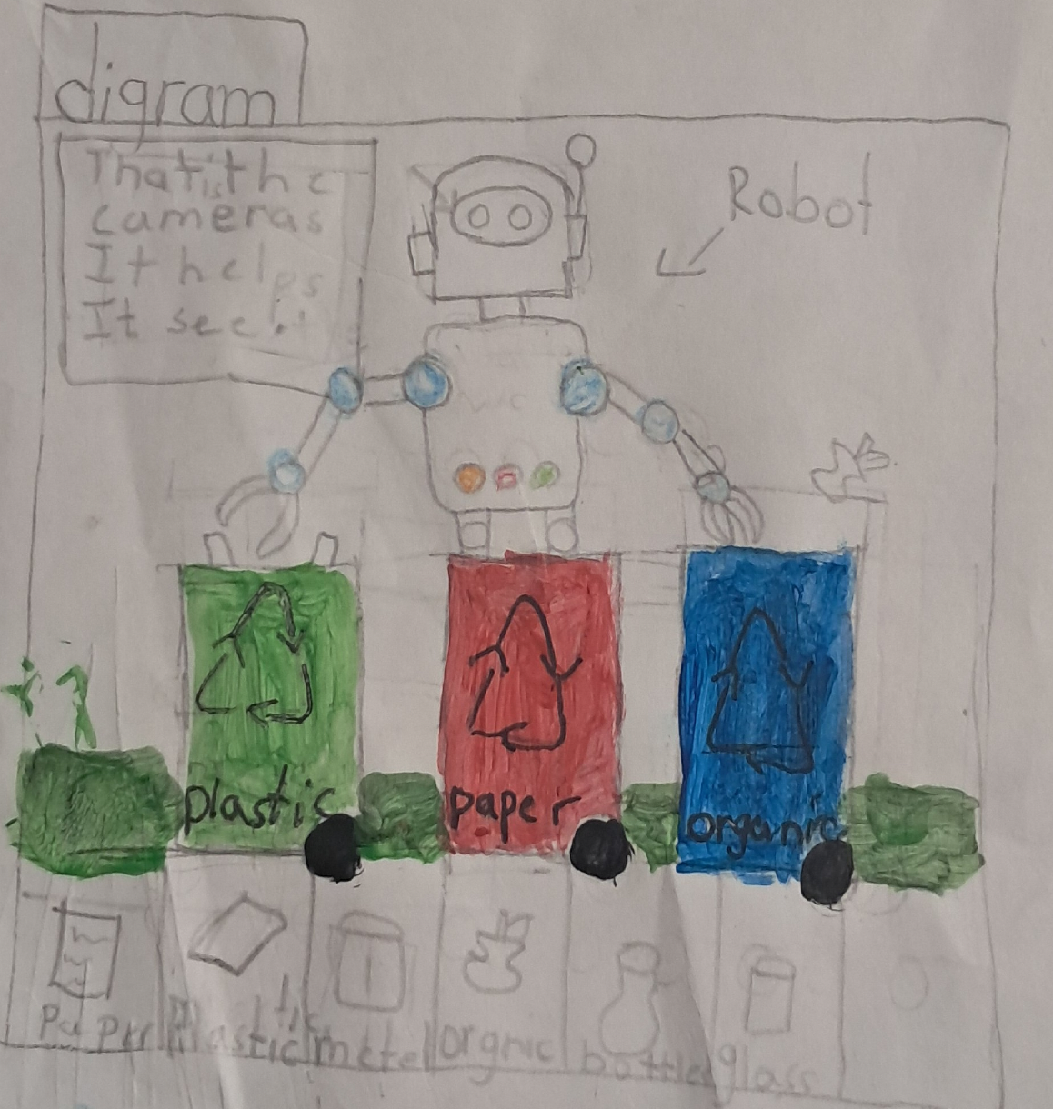
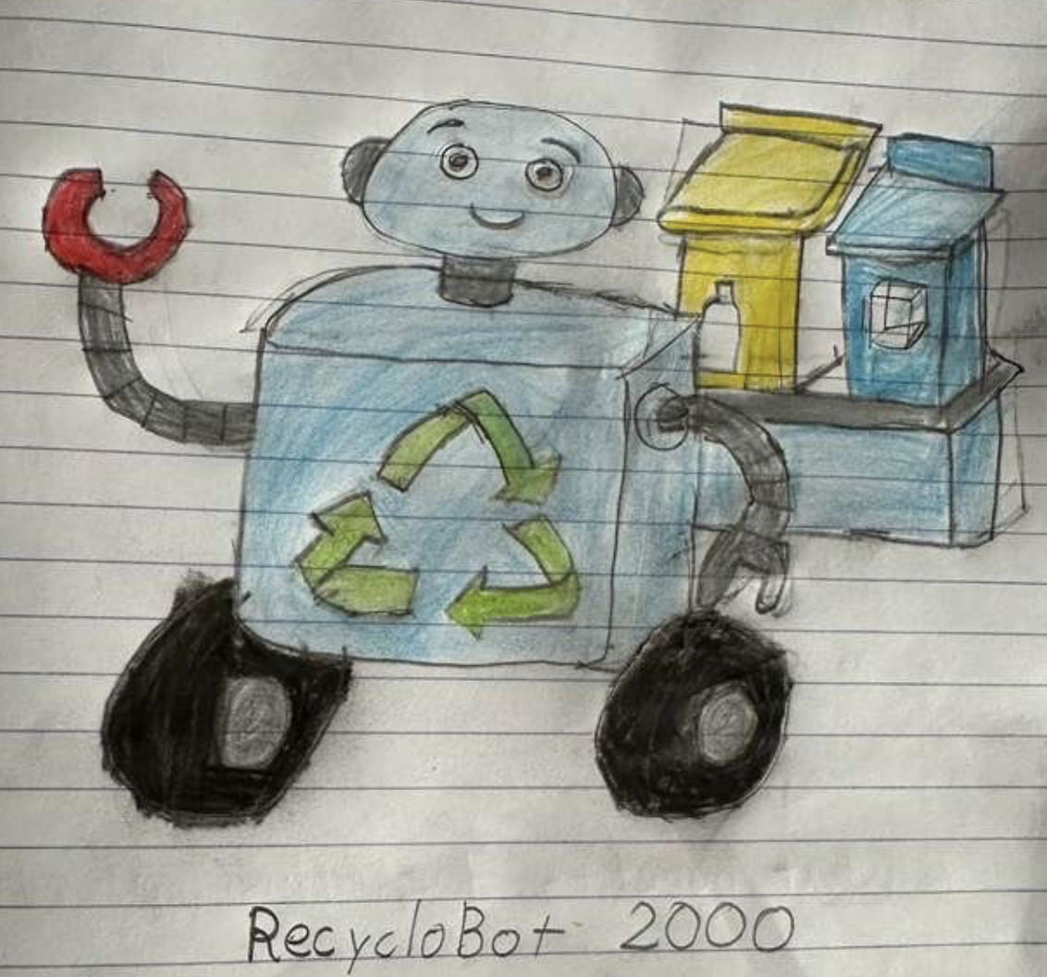
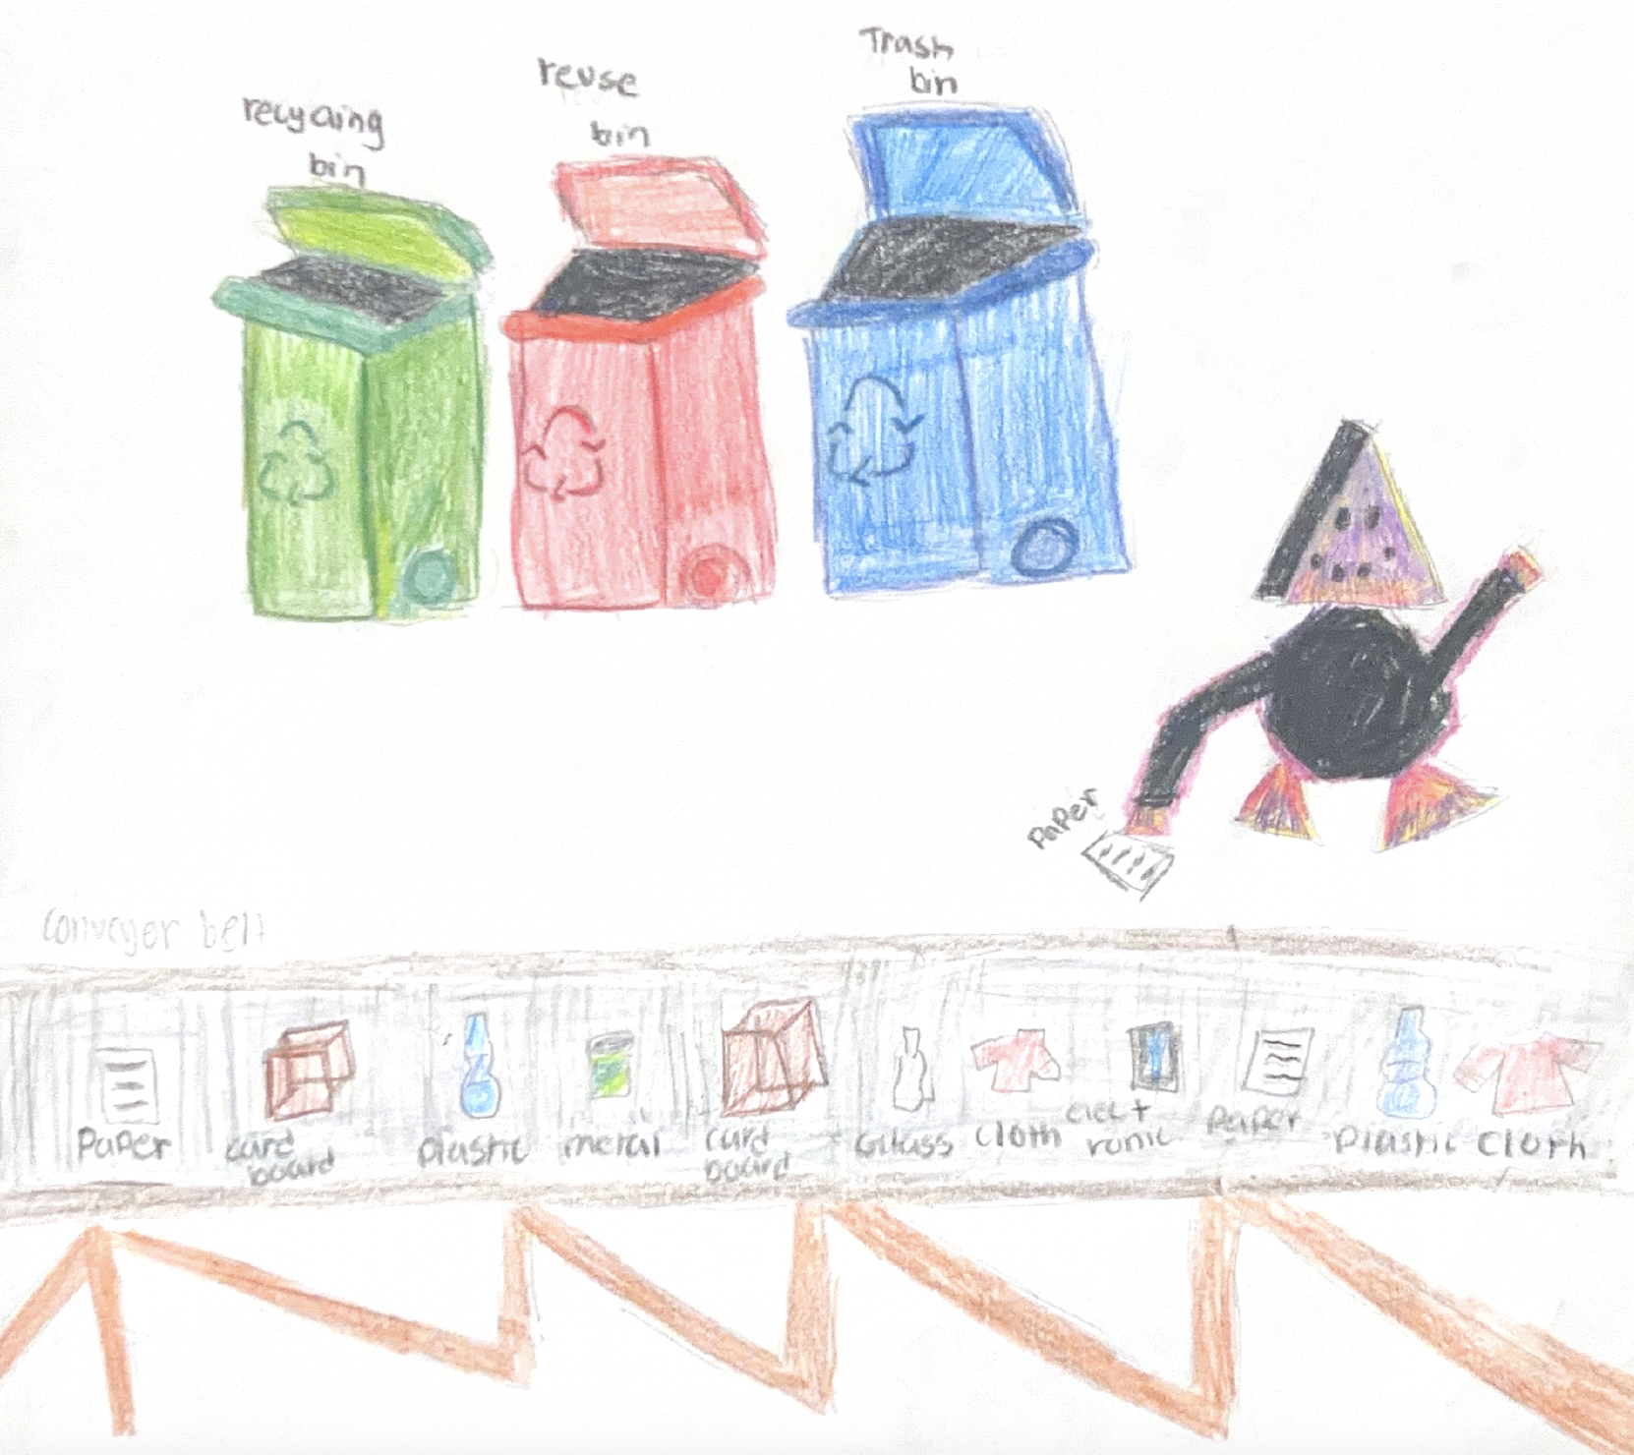
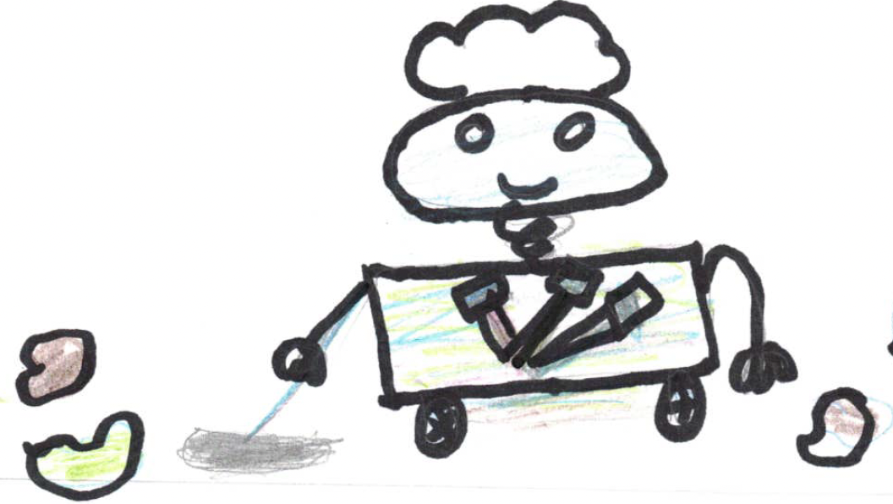
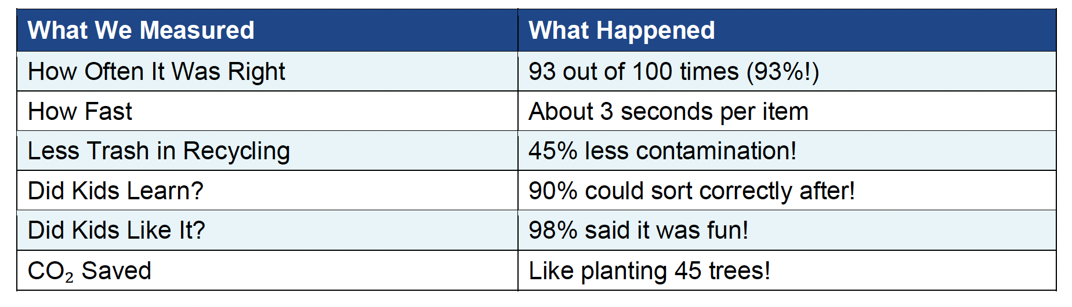
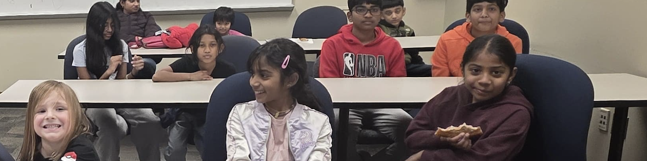
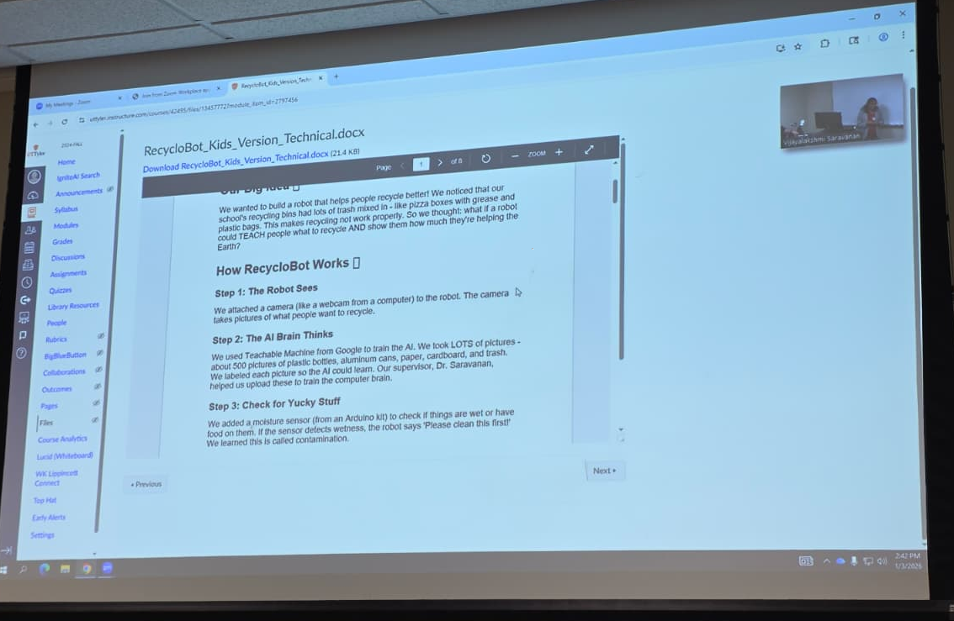
Presidential AI Challenge
Supervised By Dr. Vijayalakshmi Saravanan*
Elementary Students: Pranavi Mohan¹, Ridhvik Manikandan¹, Sashana Rajesh²,
Seyon Sakthi³, Reya Tamilmani⁴, and Denver Cole⁵
University of Texas at Tyler*, Universal Academy², Coppell, TX, GreatHearts Public Charter School² Irving TX, Harry McKillop Elementary School³, Melissa, TX,
Uplift Northhills Preparatory School⁴, Irving, TX, Andy Woods Elementary School⁵, Tyler, TX
Background
Preliminary Work by Elementary Students
The poster presents a collection of student-led artificial intelligence (AI) projects developed by K–12 students under faculty and mentor guidance. The projects were completed within a national AI education initiative supported by the Presidential AI Challenge, emphasizing hands-on learning, ethical AI, and real-world problem solving. Students from diverse grade levels collaborated with community teams to identify meaningful challenges in their local communities, and faculty and mentors guided them through the development of AI-based solutions.
These projects provided students with foundational knowledge and practical skills in AI while empowering educators to mentor students. The local community was involved in identifying real-world problems where AI could accelerate understanding and provide impactful solutions, fostering an inclusive ecosystem for preparing the next-generation of AI experts and solve the real-world problems.
This poster highlights a range of AI projects completed by students and summarizes the technical approaches used. In addition, it discusses student engagement, learning outcomes, and the skills developed throughout the project-based learning process.
Smart Recycling Robot That Teaches Us
Motivation
At schools, students observed that many recycling bins were frequently contaminated with greasy pizza boxes, plastic bags, food-stained containers, and other non-recyclable waste. When recycling bins contain excessive contamination, entire batches of recyclables are often sent to landfills instead of being properly recycled. This contamination wastes valuable resources, increases disposal costs, and reduces the overall environmental benefits of recycling. To address this issue, students explored the idea of AI-enabled robots that could help people learn what items can be recycled and demonstrate how proper recycling can reduce CO₂ emissions. This motivation led to the concept and development of the RecycloBot 2.0, an educational AI-based recycling assistant designed to promote correct recycling practices and environmental awareness.
RecycloBot2.0
AI-enabled recycling assistant that uses a camera and image recognition (AI) to identify recyclable materials such as plastic, paper, and metal.
Multi-sensor decision system that checks item cleanliness (e.g., food residue or moisture) to reduce recycling contamination.
Real-time educational feedback, guiding users to the correct bin and displaying estimated CO₂ savings from proper recycling.
Hands-on learning platform that helps students, teachers, and school staff understand recycling practices and AI concepts through interaction.
Scalable design, with planned upgrades including a conveyor belt for automated item handling and sorting.
Google Teachable Machine to learn the basics of AI training using labeled images (plastic bottles, cans, paper, cardboard).
Raspberry Pi as the on-device “minicomputer” running the system and controlling the camera workflow.
Python-based integration (guided by mentors) to connect camera input, AI predictions, and user feedback outputs.
Cloud-based Google AI (internet-connected) to enable more powerful image recognition beyond the initial classroom model.
Working Principle of our Robot
Image capture: A USB camera captures an image of the item when the user presses a button or gives a voice command; the image is stored on a Raspberry Pi.
AI-based identification: We used Google Teachable Machine for the image recognition to classify the material (e.g., plastic, paper, metal).
Contamination check: A moisture sensor verifies whether the item is wet or food-contaminated and alerts the user if cleaning is required.
Sorting guidance: Visual (LED indicators) and audio feedback direct the user to the correct bin (recyclable, reusable, or trash).
Impact feedback: The system estimates and displays CO₂ savings based on EPA data to reinforce the environmental impact of proper recycling.
Data and AI Training
Student-collected image dataset of over 1,000 photos, gathered over three weeks by students and classmates using real household recyclable and non-recyclable items.
Diverse and realistic data captured across multiple material types (plastic, metal, paper, cardboard, trash), conditions (clean, dirty, crushed), viewing angles, and lighting environments to improve AI recognition robustness.
Initial model training performed using Google Teachable Machine with labeled images (plastic, metal, paper, cardboard, trash), achieving ~85% classification accuracy.
Advanced AI integration using cloud-based Google image recognition connected to a Raspberry Pi, improving accuracy to 93%.
Iterative testing and refinement were conducted over two weeks in a real school environment, identifying failure modes such as low lighting and crushed objects.
Model improvement through retraining, including adding LED lighting for better image quality and expanding the dataset with additional examples of challenging items.
Results
After all the improvements, our robot worked well, and the results from two weeks of testing is summarized in the table.
Challenges
Learning complex technology: Students initially found it challenging to understand AI training, Raspberry Pi integration, Python workflows, and sensor systems; this was addressed through step-by-step mentoring and hands-on experimentation.
AI misclassification errors: Early models struggled with crushed or crumpled items and low-light conditions; accuracy improved through additional data collection, retraining, and improved lighting.
User interface visibility: Small displays, dim LEDs, and low audio volume made guidance difficult in noisy environments; solutions included larger screens, brighter LEDs, clearer visual indicators, and adjusted audio feedback.
Large-scale data collection: Gathering over 1,000 images required sustained effort; this challenge was overcome by involving the entire class, tracking progress, and maintaining motivation through collaborative activities.
Innovation and Scalability
Interactive, educational design that teaches correct recycling through real-time guidance, visual cues, and environmental impact feedback.
Use of real-world AI technology, with students engaging in image recognition concepts supported by cloud-based AI systems.
Engaging and gamified experience, using LEDs, audio feedback, and impact messages to encourage participation and learning.
Scalable and extensible architecture, with planned upgrades such as conveyor-belt automation, expanded material classification, and classroom-based challenges.
AI and Robotics concepts for Recycling and Environmental Sustainability
Pranavi’s Robot
Ridhvik’s Robot
Our Team
Students
Elementary students from various schools participated in this project.
Students were primarily involved in problem identification, data collection (image gathering), testing, and iterative improvement of the system.
Through guided activities, students learned foundational AI concepts, how data is used to train models, and how AI systems behave in real-world conditions.
Learnt the Google Teachable Machine tool.
Supervisor (Dr. Vijayalakshmi Saravanan)
Dr. Vijayalakshmi Saravanan (Supervisor) provided technical leadership and mentorship throughout the project.
She introduced students to Google Teachable Machine software tool, artificial intelligence concepts, demonstrated how Raspberry Pi–based systems operate, and implemented the core Python-based AI and hardware integration.
She also guided students through AI training, testing, troubleshooting, and model improvement, ensuring that students understood each component rather than passively observing.
Instructional support included helping students connect the project to mathematics and environmental science, including CO₂ impact calculations.
Parents
Parents assisted with physical construction, logistics, transportation, and access to tools and devices such as webcams and tablets.
Families played an important role in encouraging persistence and motivation during challenging phases of the project.
HPC-AI Team Members at UT Tyler ( Dr. Tupendra Oli, Jon Ryan Cole, Sai Karthik Navuluru)
Mentors supported students by assembling hardware components, assisting with device integration, and refining project designs through feedback and suggestions.
Reya’s Robot
Sashana’s Robot
Concept sketches created by elementary students illustrating early ideas for AI-enabled recycling
What They Learned?
AI learns from data: Students learned that AI performance depends on the quality, quantity, and diversity of training examples.
AI is not perfect: Model predictions can be incorrect, highlighting the importance of testing, validation, and human-in-the-loop decision making.
Bias and fairness matter: Training with diverse examples improved performance and demonstrated how biased data can limit AI systems.
AI should support people: The robot was designed to teach and assist users, reinforcing that AI should help people learn rather than replace them.
Technology should solve real problems: Students applied AI to a real community challenge—recycling contamination—emphasizing purposeful technology use.
Growth through collaboration and persistence: Students developed problem-solving skills, teamwork, patience, and confidence through iterative testing and mentorship.
Cost Saving Impact
By automatically sorting recyclables and reducing contamination, RecycloBot can save janitors 1–2 hours per shift previously spent on manual sorting and bin rechecks, translating to $3,000–$7,000 annual labor savings per facility.
Students Reflections
Reya: “RecycloBot helps janitors by reducing manual waste sorting, saving time, and improving recycling.”
Pranavi: “The project was fun and taught me teamwork and creative problem-solving.”
Ridhvik: “I loved experimenting with the robot and seeing our code work in real life.”
Sashana: “Building RecycloBot was fun and showed me how AI can solve real problems.”
Seyon: “I enjoyed testing the robot and learning how machines can recognize objects.
Denver: “AI Robot was FUN”
“RecycloBot2.0: AI Helping People, Helping Planet.”

